Slide 1



Order Placement System
Software Development & Architecture
Presented by
Syed Mubashir Hassan

Slide 2
Agenda
Usecase Diagram
Usecase Descriptions
Activity Diagram
Sequence Diagram
State machine
Class diagram
Component Diagram
Petri Nets

Slide 3
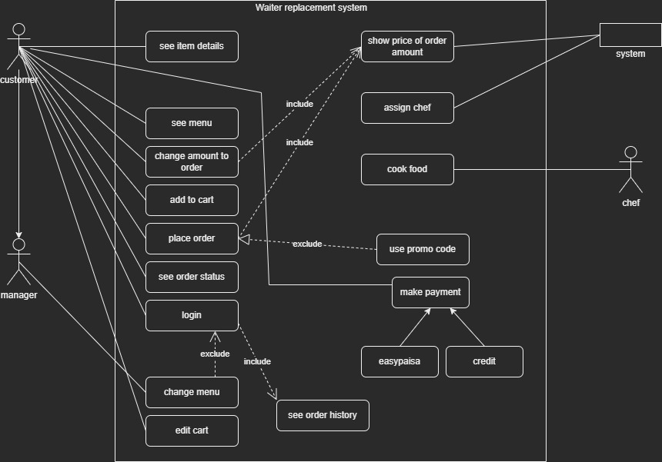
UseCase Diagram

Slide 4
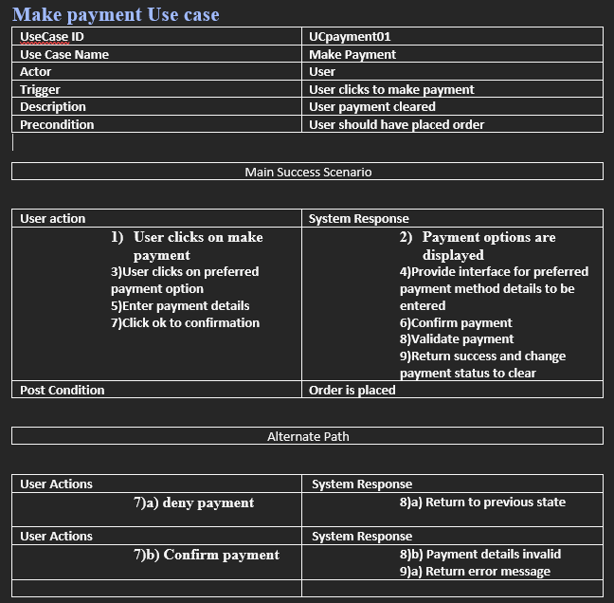
Make payment

Slide 5
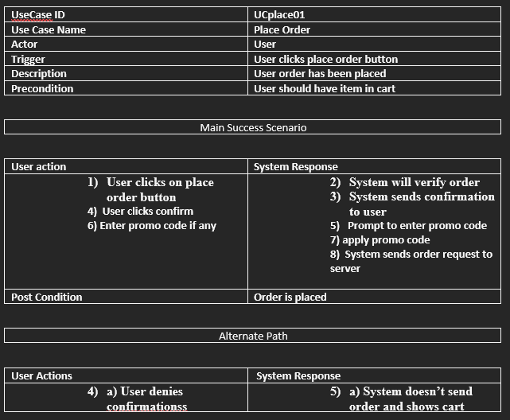
Place order

Slide 6
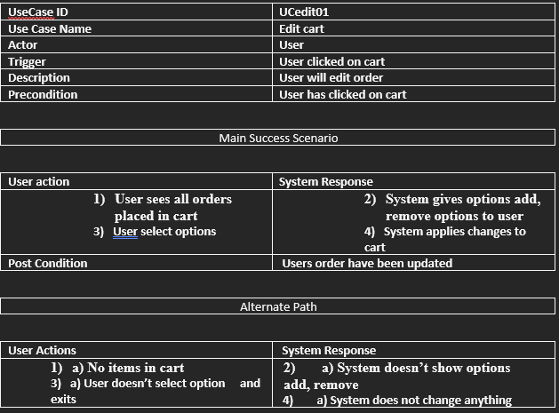
Edit cart

Slide 7
Activity diagrams

Slide 8
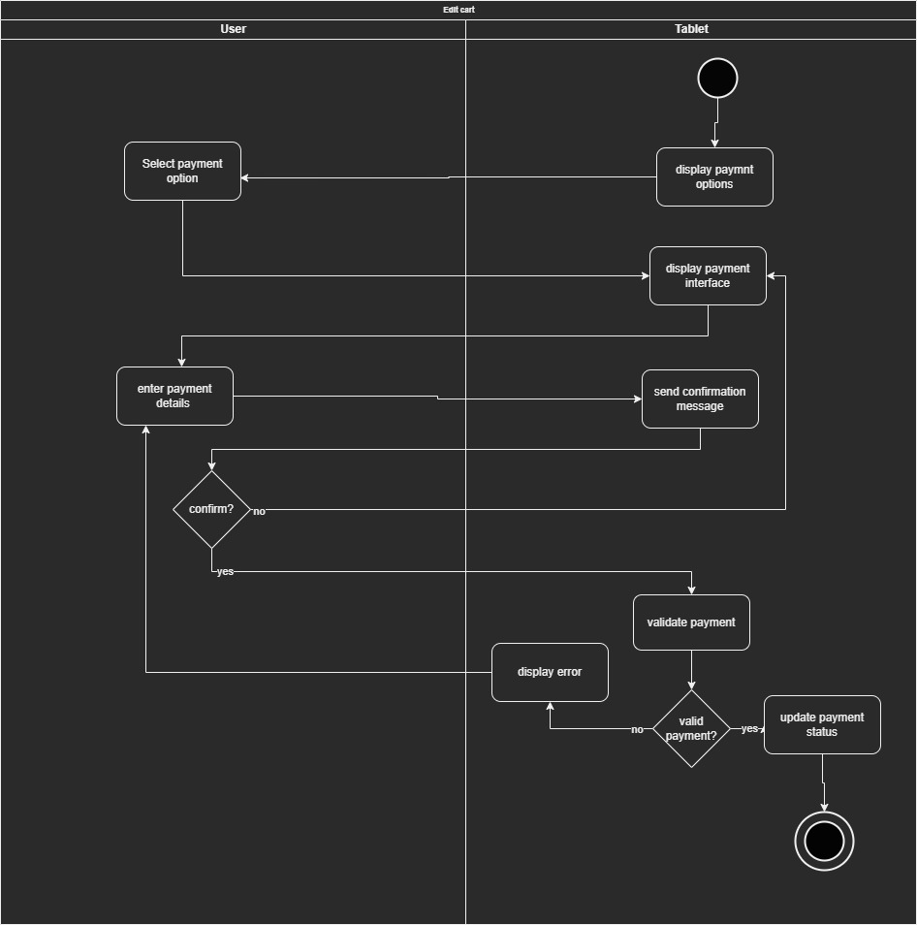

Slide 9
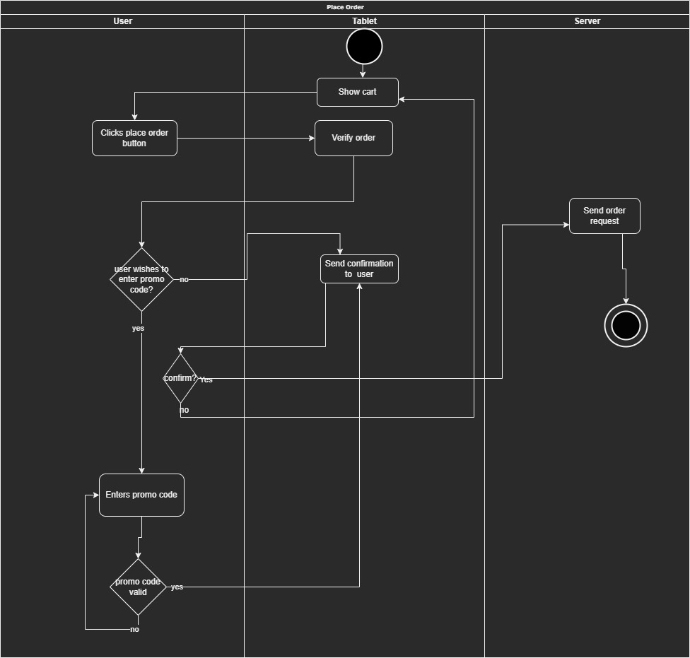

Slide 10
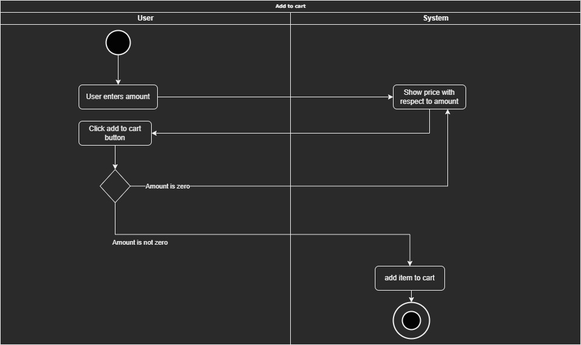

Slide 11
Sequence diagrams

Slide 13
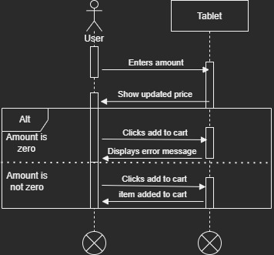

Slide 14
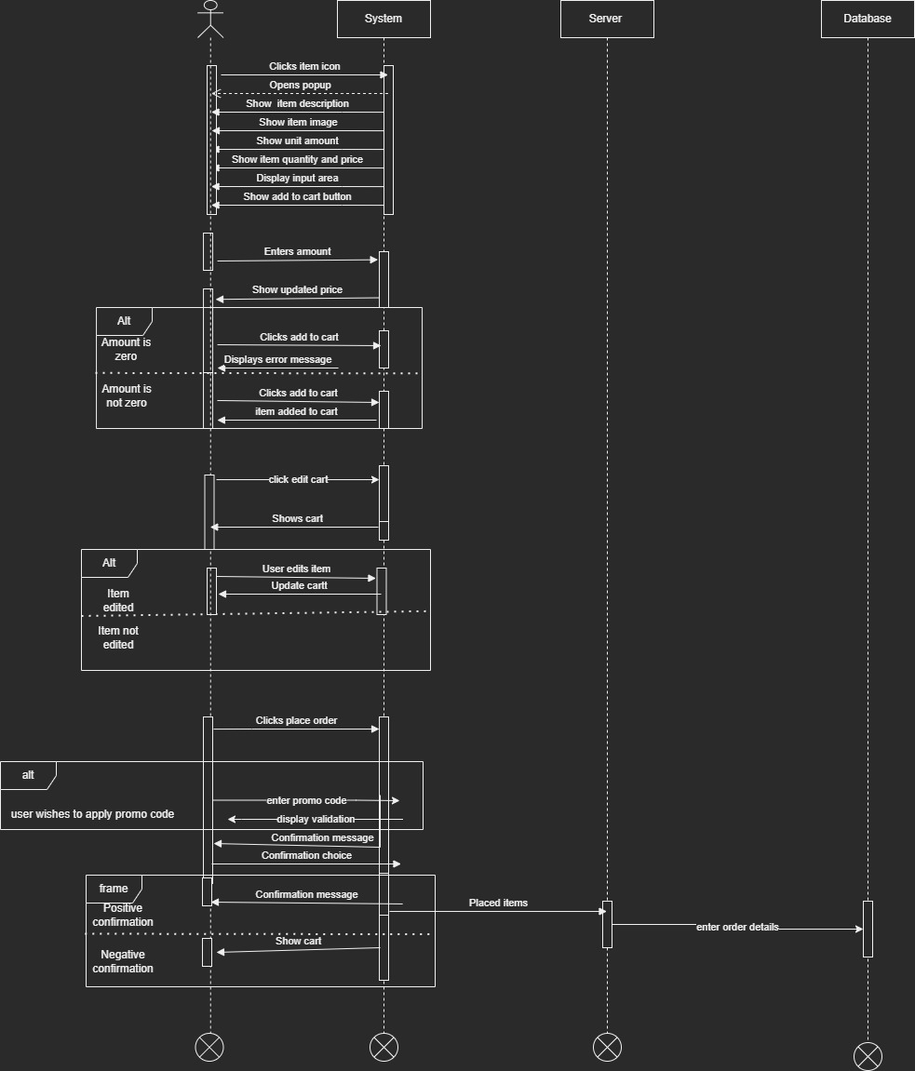

Slide 15
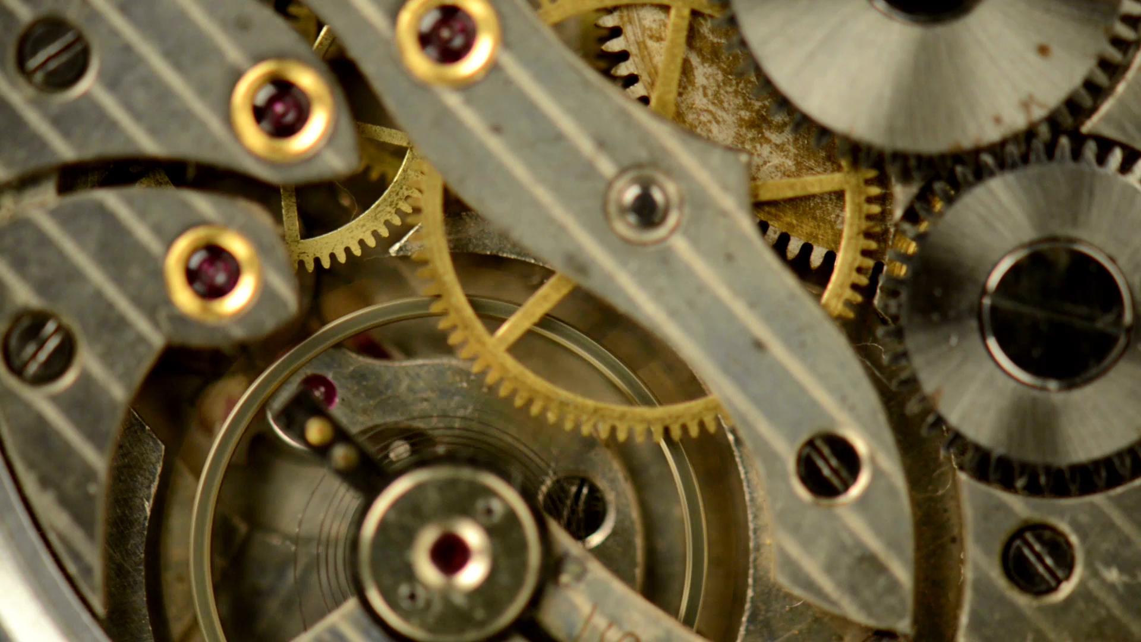
State machines

Slide 16
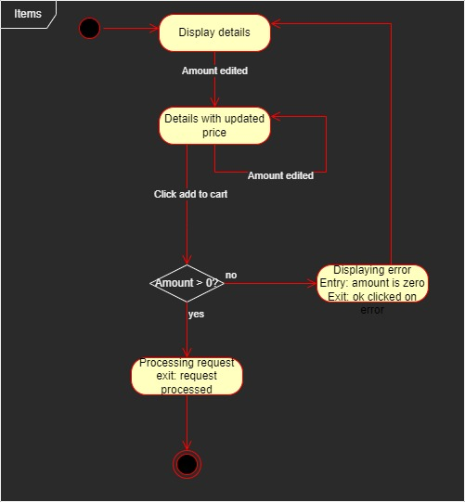

Slide 17
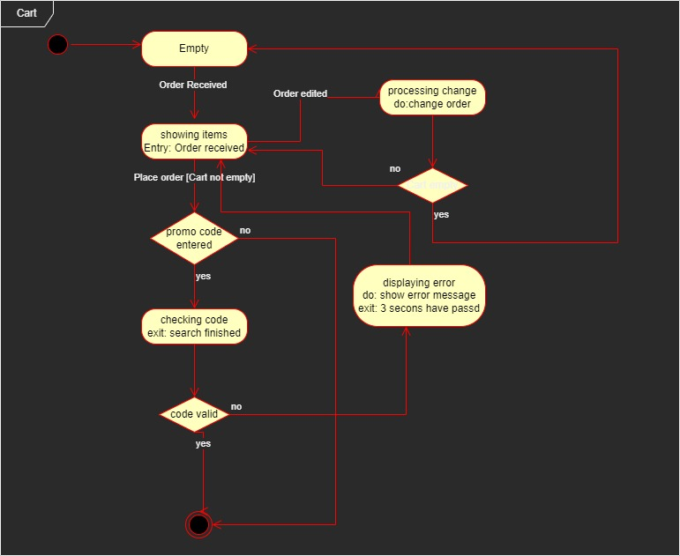

Slide 18
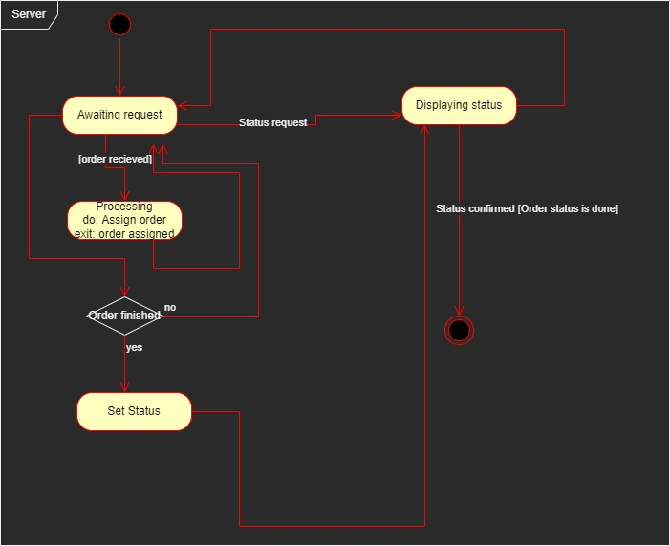

Slide 19
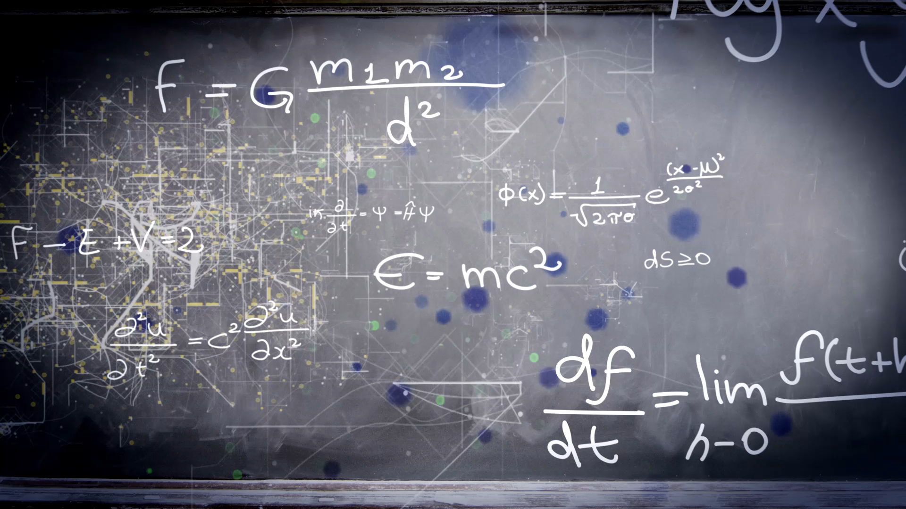
Class diagram

Slide 20
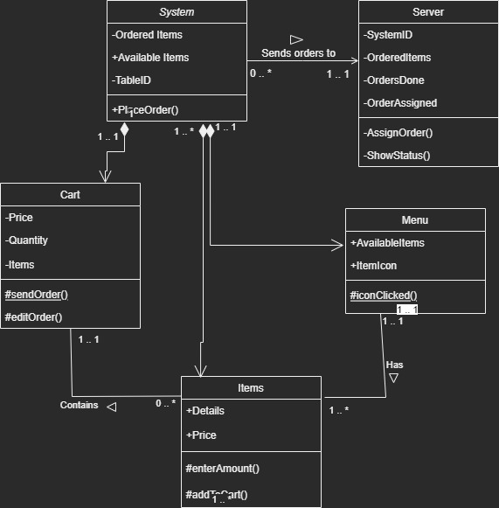

Slide 21
Component Diagram

Slide 22
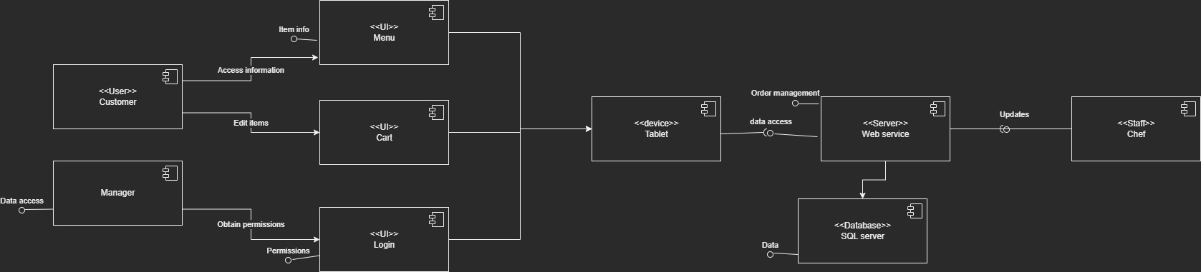

Slide 23

Deployment Diagram

Slide 24
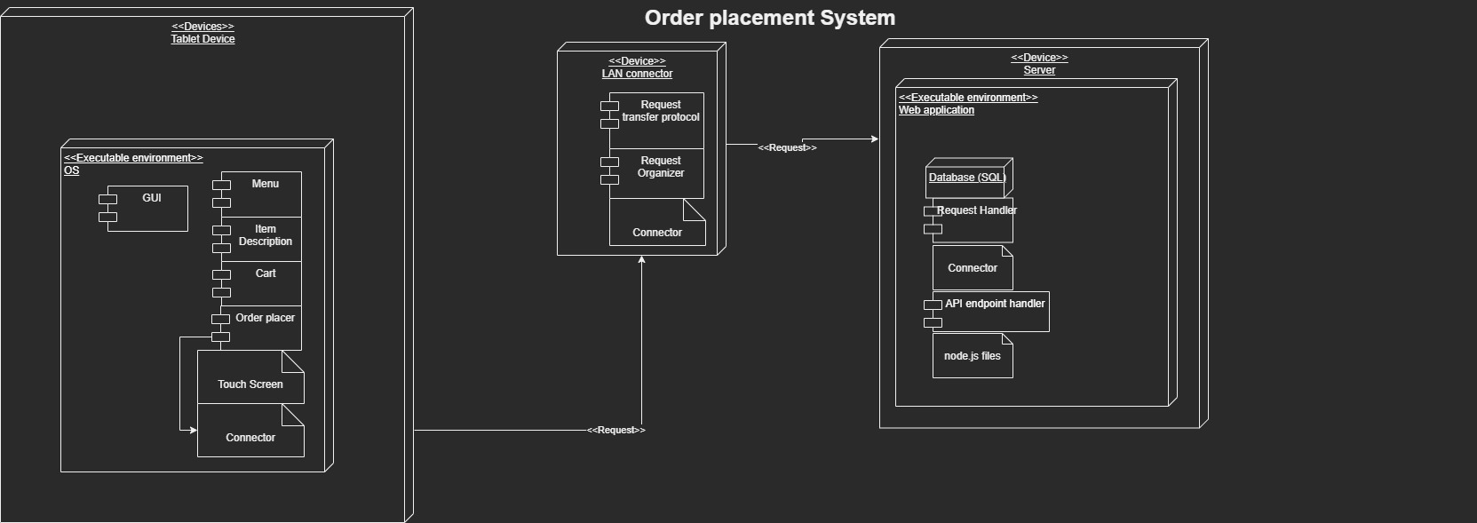

Slide 25

Petri nets

Slide 26
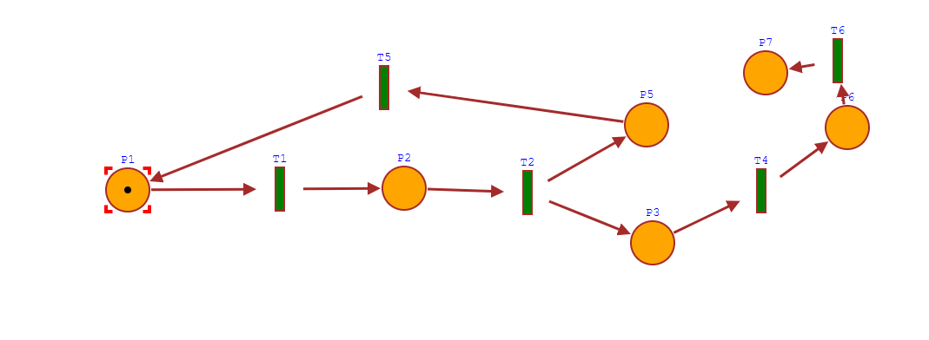

Slide 27
Question?
Queries?

Slide 28

Thank you
That is all

